Slide 1

PeacePlan: A Web Application for Mental Health Assistance
By Loluță Ștefana
Supervisor Lector Dr. Surdu Sabina

Slide 2

PeaceBot, the chatbot implemented in the PeacePlan application was presented at the Scientific Communication Session of Students, Informatics, 2024

Slide 3
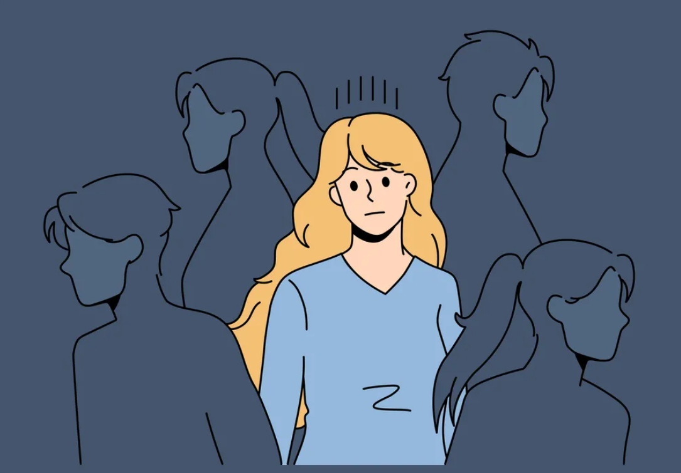

Slide 4
Introduction
Context and Motivation
Global use of resources, communication and information have all experienced radical change because of rapid technology improvements.
Difficulty in choosing the best tools when developing due to the wide variety of frameworks libraries and programming languages.
Technology has the potential to significantly improve mental health, targeting an increasing number of mental health problems with scalable, accesible and affordable solutions.

Slide 5

Thesis Objectives
Development of PeacePlan, a web application which aims to enhance accessibility to mental health services.

Slide 6

Problem Statement
Growing concerns with mental health ; new, scalable and easly available solutions are in high demand worldwide.
The availability of the mental health care today is frequently restricted by logistical, financial and by location.
The need for an integrated platform providing professional therapy and automated emotional assistance in addition to comprehensive mental health support.

Slide 7
Proposed Solution
PeacePlan Application Main Features
1. User-Therapist Matching System
Users complete a mental health assessment.
The system matches users with therapists who best meet their needs.
2. PeaceBot Chatbot
Users interact with PeaceBot for real-time support and advice.
3. Appointment Scheduling
Users can easily book appointments with therapists.
Simplifies the scheduling process to ensure timely access to therapy.

Slide 8

Technologies Used
Frontend: React and TypeScript
Backend: Django framework + Flask
Chatbot Technology: Utilizes QLoRA approaches to fine-tune the LLaMA 2 model.
Security Measures: MailerSend for two-factor authentication and JWT tokens for secure authentication.

Slide 9
PeaceBot implementation Data Collection and Preparation
Data set from Hugging Face :
heliosbrahma/mental_health_chatbot_dataset
Tokenized and organized the data to get the best possible training results
Why did we choose this dataset?
Relevance
Diversity
Quality
Accessibility
Size

Slide 10
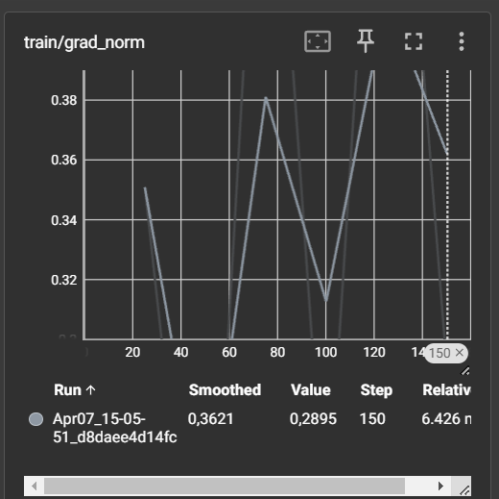
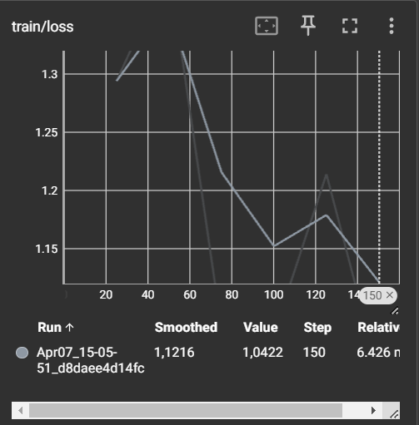
Model Training and Optimization
Fine-tuning LLaMA 2
Decreasing the model size by quantization.
But how? We switched from 32-bit parameters to 4-bit.
This resulted in an eight fold reduction .
Kept an eye on important training variables including gradient norm and loss.

Slide 11

Demo time!

Slide 12
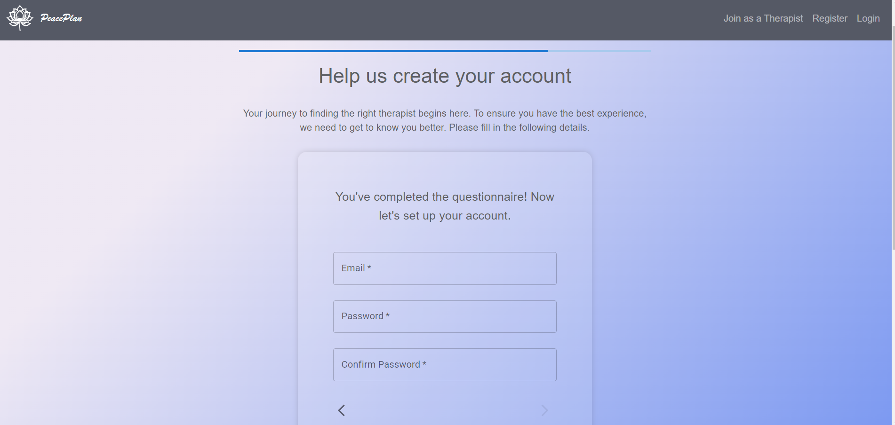
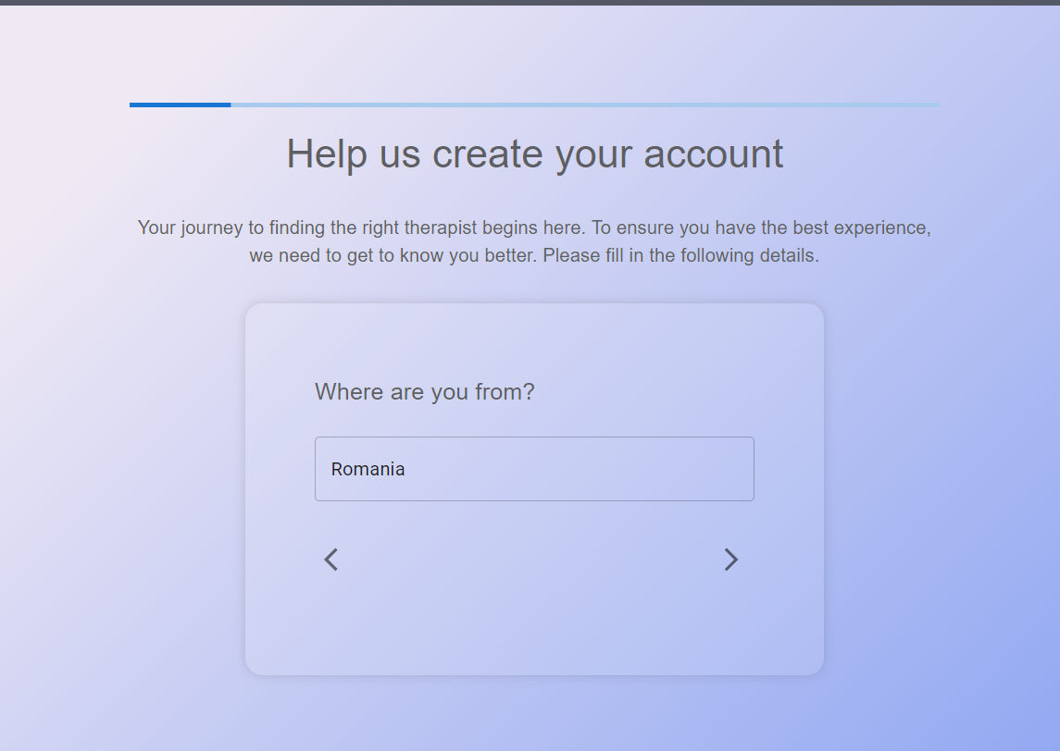
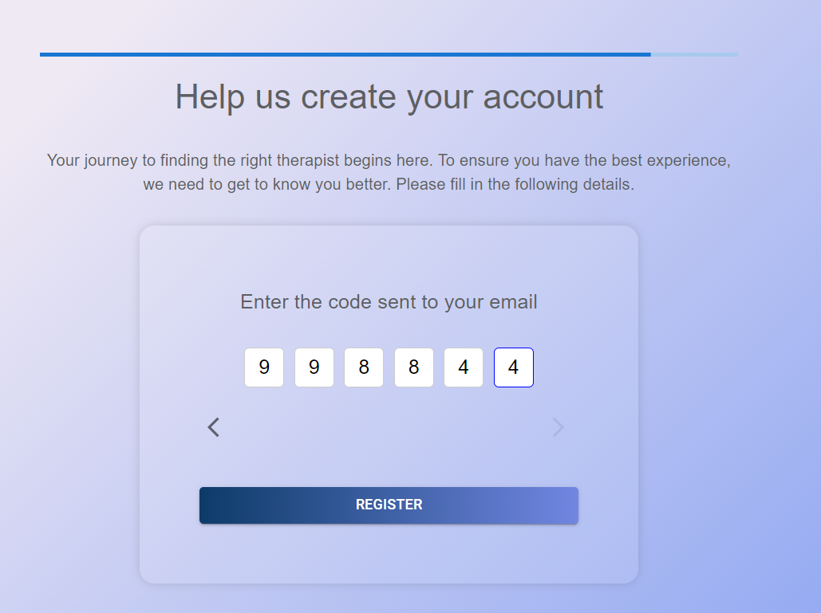
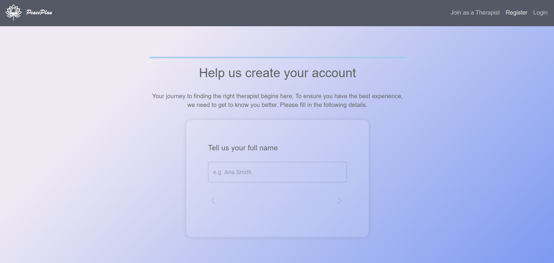
More features of Peace Plan
User Register
Therapist Register, similar to user register

Slide 13
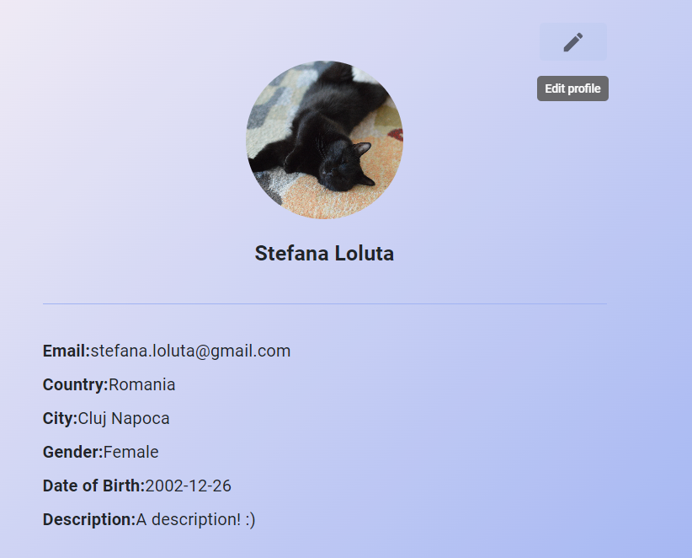
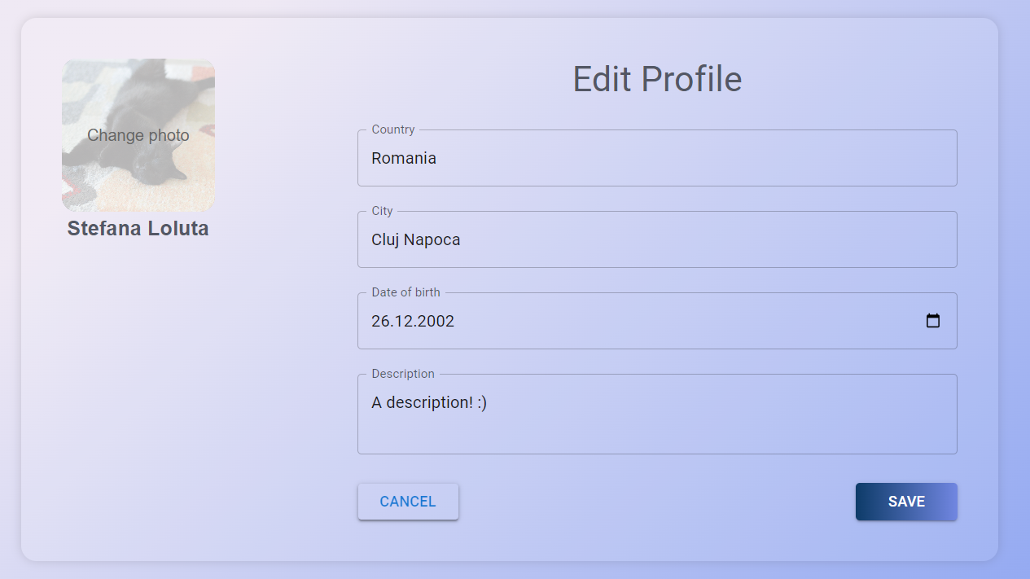
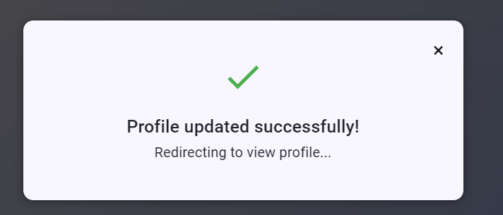
User see and edit profile ( similar to therapist see and edit profile )

Slide 14
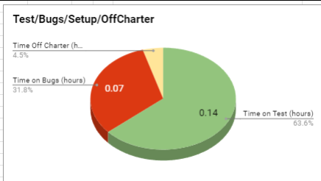
Testing and Evaluation
Unit Testing: Ensures individual components function correctly.
User Acceptance Testing: Validates the application meets user needs and expectations together with exploratory testing.
Tested PeaceBot responses for some user inputs.

Slide 15
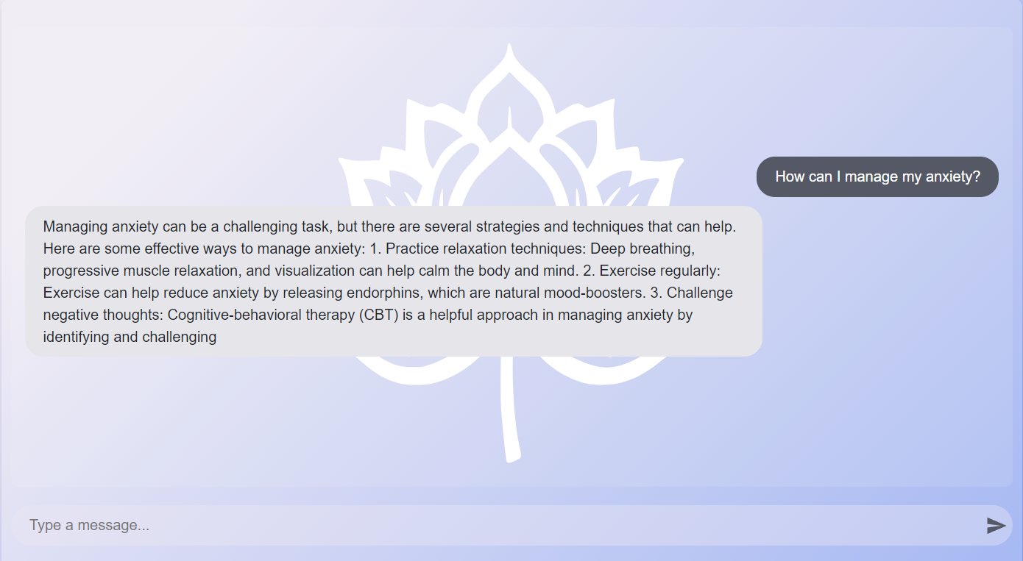

Slide 16
Conclusion
PeacePlan aims to incorporate modern technology to address major issues in the accessibility of mental health services.
By offering a platform for mental health support, the application aims to improve user satisfaction and the efficacy of therapy.

Slide 17

Future ideas and improvements
Explore additional features to further personalize user experiences.
Improve matching user to therapist algorithm
Improve PeaceBot accuracy and response time.

Slide 18
Thank you for your attention!

